Slide 1


Slide 2

A
Presentation
On
Playwright
Fast and reliable end-to-end Testing for modern web apps
Presented By
Rushikesh Patil (QA Engineer)
rushikeshv.patil@infobeans.com

Slide 3
Agenda
What is Playwright.
Features of Playwright.
Playwright Architecture.
Why Playwright ?
System Requirements.
Supported Languages,Browsers & Reporting Tools.
Advantages & Limitation of Playwright.
Compare Playwright with others.

Slide 4
What is Playwright?
Playwright is an Open-Source & Free test automation library initially developed by Microsoft contributors.
Any browser • Any platform • One API
Reliable end-to-end testing for modern web apps
Powerful automation capabilities .
Playwright supports Functional, End to End, and API Testing.
Playwright comes with Apache 2.0 License and is most popular with NodeJS with Javascript/Typescript.
First release was in January 2020.
40.6K GitHub stars and 1.9K GitHub forks

Slide 5
Features of Playwright
Excellent Inbuilt features like
Traces,Automatic Screenshot,Test Video Recording
It provides Inspector Tool which helps us to monitor & debug every step of execution.
In Built API testing libraries
It provides Browser Context feature which help to save & transfer browser state to any other browser
Provides Codegen Tool which genrates test code by recording your actions save them into any languages.
with the above feature Playwright is tough compititor for Selenium & Cypress automation tool
https://discovery.hgdata.com/product/playwright

Slide 6
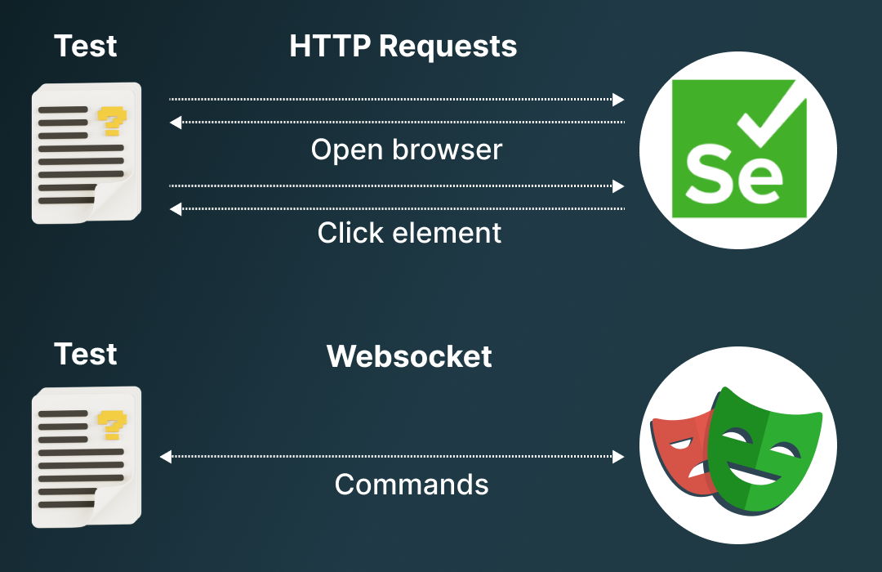
Playwright Architecture

Slide 7
Why Playwright
Modern web apps are higher user expectation & greater demands
a) cloud-hosted & Scalable
b)SPA behaviour supported (eg.https://paytm.com)
c)Modular & loosly coupled
d)Most of the work done at Backend.
Playwright is able to launch Blink,Gecko,Webkit Engine giving everything Selenium can do & additionally providing all important features not available in selenium ,it lacks the ability of
To catch any page life cycle events,log messages & exceptions being thrown
Inspect & optionally mock all network requests between client & server side

Slide 8
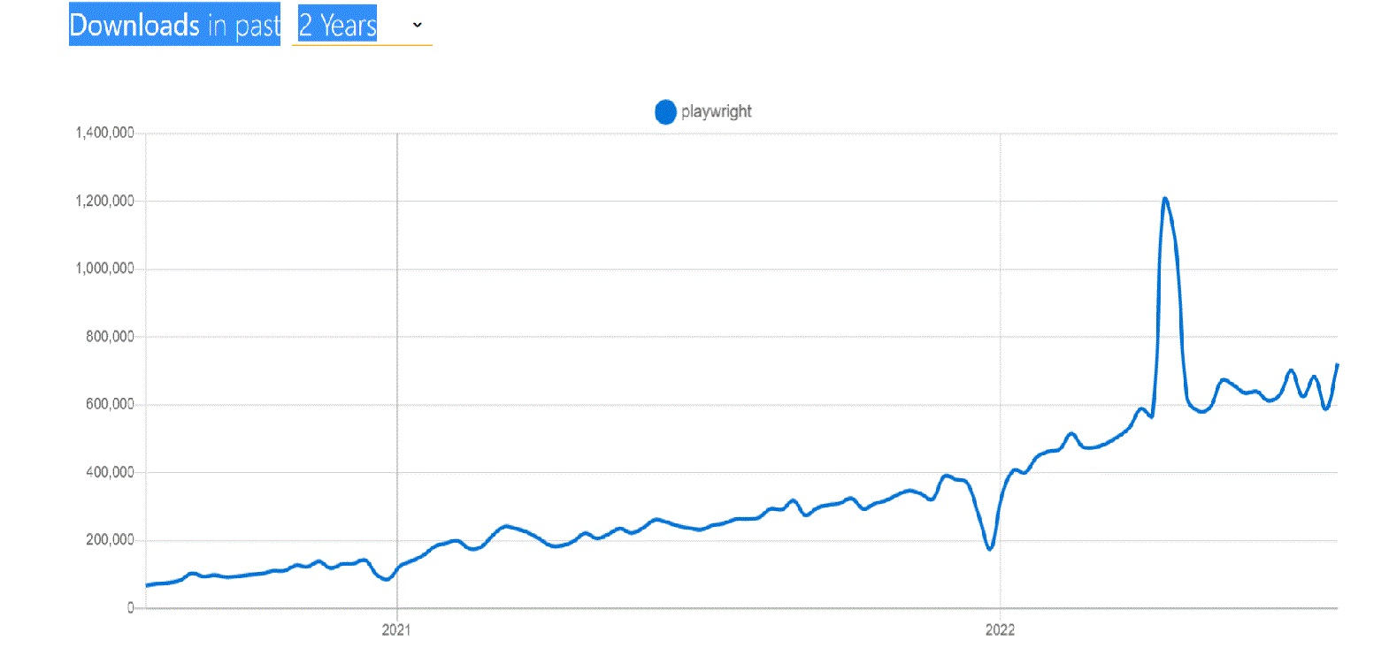

Slide 9
System Requirements
Windows: Works perfectly fine with windows 10 or above.
Mac OS: It needs 10.14 Mojave or above.
Linux: Depending on the version of Linux, additional dependencies are needed to run the browsers. Only Ubuntu 18.04 and 20.04 are officially supported.
Prerequisites:
Node JS: Playwright requires a node.js version that is 14 or above.
IDE:
Visual Studio Code
Eclipse
IntelliJ IDEA

Slide 10
Advantages & Limitation of Playwright Framework
Advantages
Limitation
Easy Setup and Configuration
Multi-Browser Support:
Multi-Language Support:
Parallel Browser Testing:
Support for Multiple Tab/Browser Window:
CI/CD Integration Support:
Debugging Tools Support: Playwright Inspector
Tracing.
Auto-wait
Codegen
Playwright is new, and it’s still evolving. Scope for improvement.
Playwright doesn’t support Native Mobile Apps.
Though Playwright documentation is excellent, we cannot expect much when it comes to community support. Since Playwright is new to the market user base is still growing.
Playwright can patch Firefox and Webkit layout engines.
There is also no support for IE11, which makes it impossible to work with non-browser platforms.
Playwright can provide text execution and development of browser context for every test, but its limited support for Android and web browsers are difficult to overcome

Slide 11
Supported languages,Browsers &Reporting Tools
JavaScript
TypeScript
Python
Java(version 8 or above)
.NET
•Chromium (84 & above)
•Firefox (76 & above)
•WebKit (13 & above)
•Google Chrome (Chrome 66 & above)
•Microsoft Edge (Edge 80 & above)
Reporting Tools Dot Reporter(By-dafult) Line Reporter JUnit XML Reporter JSON Reporter List Reporter. Allure reports(recently)

Slide 12
Code Demo
Selenium
Playwright
public static void main(String[] args)
{
System.setProperty("webdriver.chrome.driver","G:\\chromedriver.exe");
WebDriver driver = new ChromeDriver();
driver.get("http://playwright.dev");
System.out.println(driver.getTitle())
}
}
public static void main(String[] args)
{
Playwright playwright = Playwright.create();
Browser browser = playwright.chromium().launch();
Page page = browser.newPage();
page.navigate("http://playwright.dev");
System.out.println(page.title())
}

Slide 13
Lets Compare Playwright with others
Click me

Slide 14
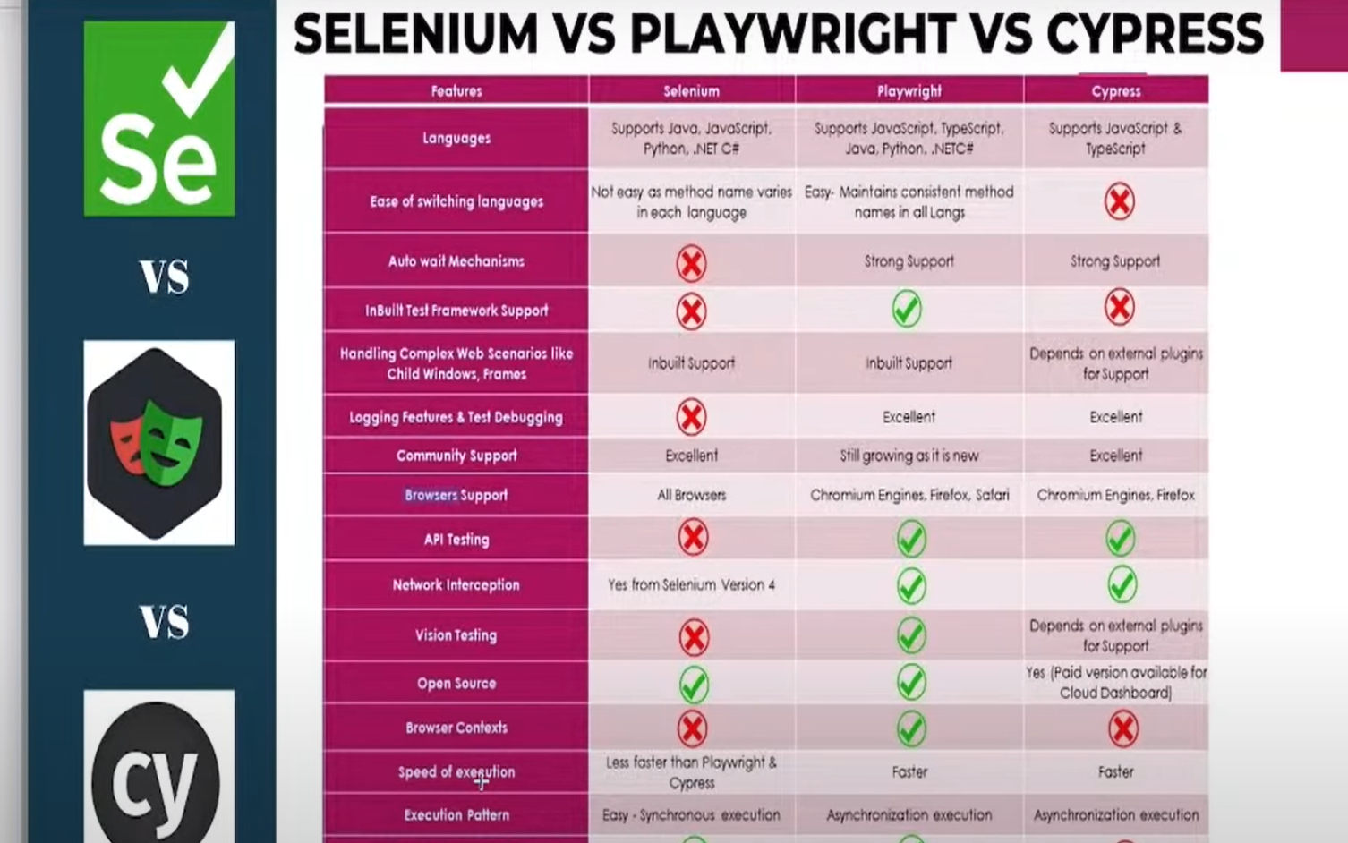

Slide 15
Sources
https://playwright.dev
https://github.com/microsoft/playwrigh
https://playwright.dev/docs/api/class-playwright
https://www.programsbuzz.com/article/playwright-vs-puppeteer
https://stackshare.io/playwright
https://www.browserstack.com/guide/playwright-tutorial
https://testsigma.com/blog/playwright-alternatives
https://www.lambdatest.com/playwright
https://www.youtube.com/playlist?list=PLFGoYjJG_fqrjcgRUcc2ubbZGtbRcC6W8
https://www.youtube.com/watch?v=ycsl8Nd6H4I&list=PL8VbCbavWfeG6yNh-dtRccLKXWewsvyK8
https://docs.microsoft.com/en-us/dotnet/architecture/modern-web-apps-azure/
https://npmtrends.com/playwright

Slide 16


Slide 17


